Slide 1

Predicting Response Time in EMS arrival
Al-Jalil Gault | David Park | Public Policy Analytics
Illustration: WheelchairTravel.org
Notes:
The purpose of this project is to help users understand how long it will take for an ambulance to arrive. When someone is in need of medical services, knowing the fastest ways they can receive medical attention is important. We want to create a tool that supports the well-being and safety of all people, in the most efficient way possible.

Slide 2
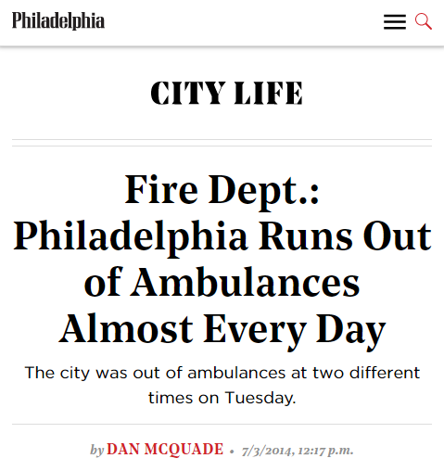
Delays in Emergency Medical Services are an Imminent Threat
A Study of North Los Angeles County, found that 14.8% of EMS calls were delayed.
The average time of the delay was 35 mins.
Notes:
Delays in EMS are an imminent threat. A study in north LA found that roughly 14.8% of EMS calls were delayed. The average wait time of a delay was 35 mons. Even in Philadelphia, this article to the right shows that we run out of ambulances everyday due to overcapacity. These delays are a problem.

Slide 3
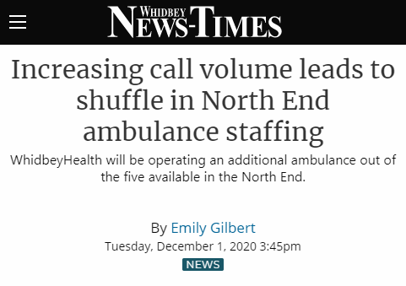
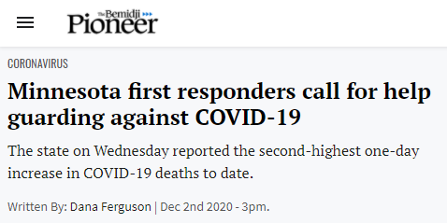
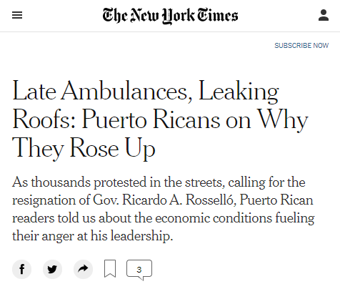
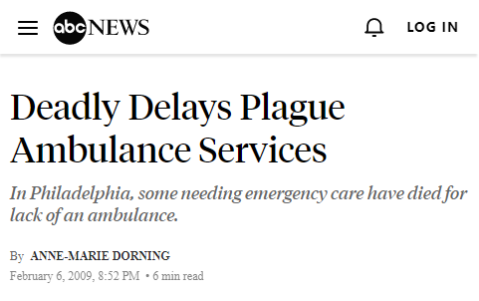
We Must Plan for Adjustments
Notes:
We must plan for adjustments. Delays are a problem for hospitals, workers, and citizens in need. Even today, delays in EMS services are catalyzing civic unrest in Puerto Rico, causing first-responders to call for additional help, and putting lives at risk.

Slide 4
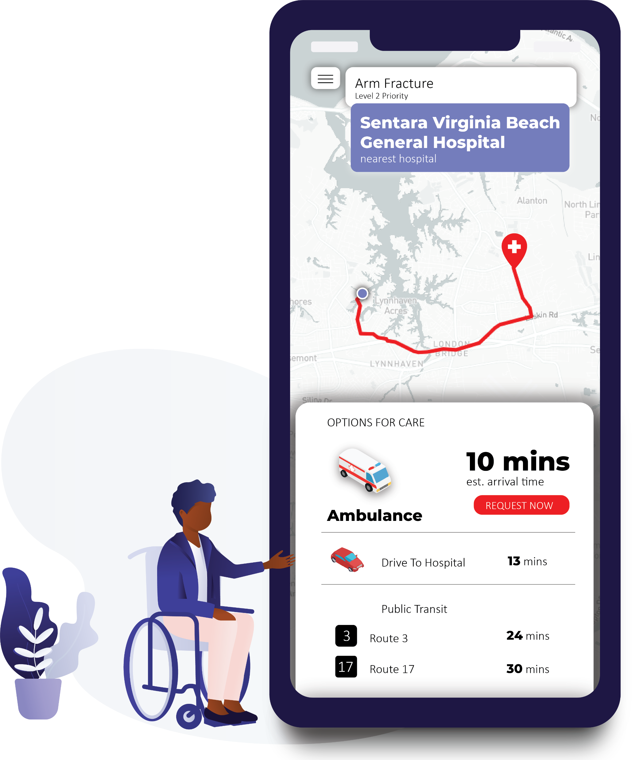
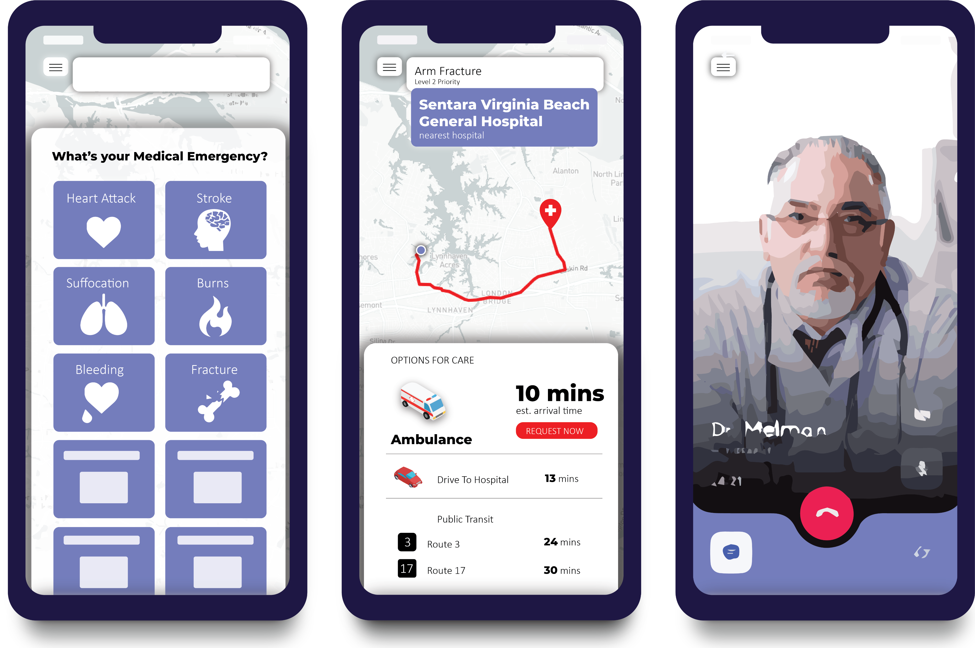
Knowledge for those in need:
MyEMS
Select your Emergency
Receive timing for care
Get help while waiting
Notes:
We would like to present MyEMS, an app to help users understand how long it would take if they request an ambulance, make an informed decision about how to get care based on all other options, including car travel and public transportation. The app will also allow them to receive telemedicine while en route.

Slide 5
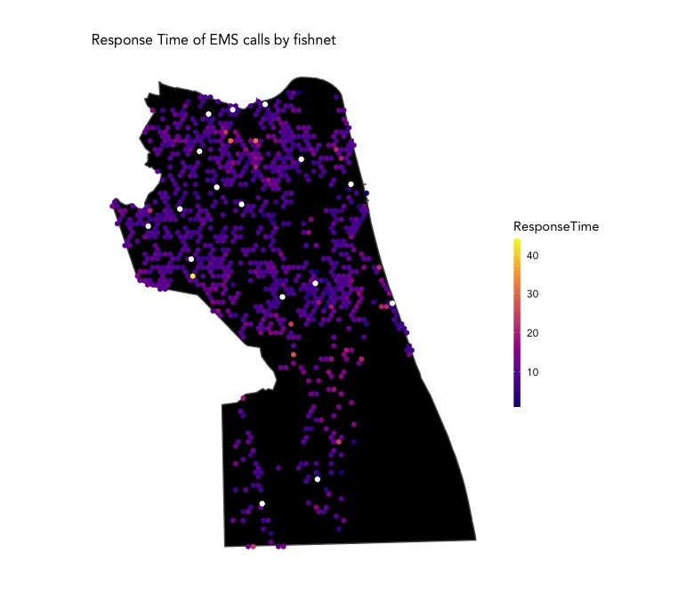
How do we know?
EMS Stations
Notes:
The key question is: How do we know how long it will take for an ambulance to arrive on scene of an emergency? We’ve obtained a history of EMS calls from Virginia Beach. Based on 2 years of data, we’re able to use delay patters from the past and predict delays into the future. The map on the right shows how these response times are distributed throughout space.

Slide 6
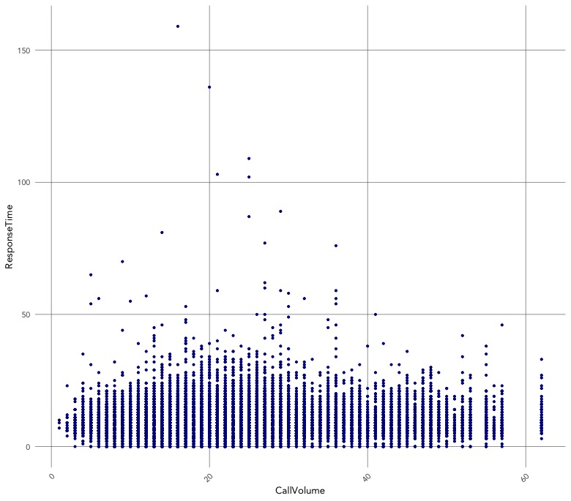
Patterns from
Historical Calls
Volume of Calls
Call Volume is not the sole predictor of EMS Delays
Notes:
If we examine the relationship between call volume and EMS response time, we can see that call volume is not the sole predictor of EMS delays. So, what are some other factors that contribute to delays? I’ll spend the rest of this presentation exploring this question.

Slide 7
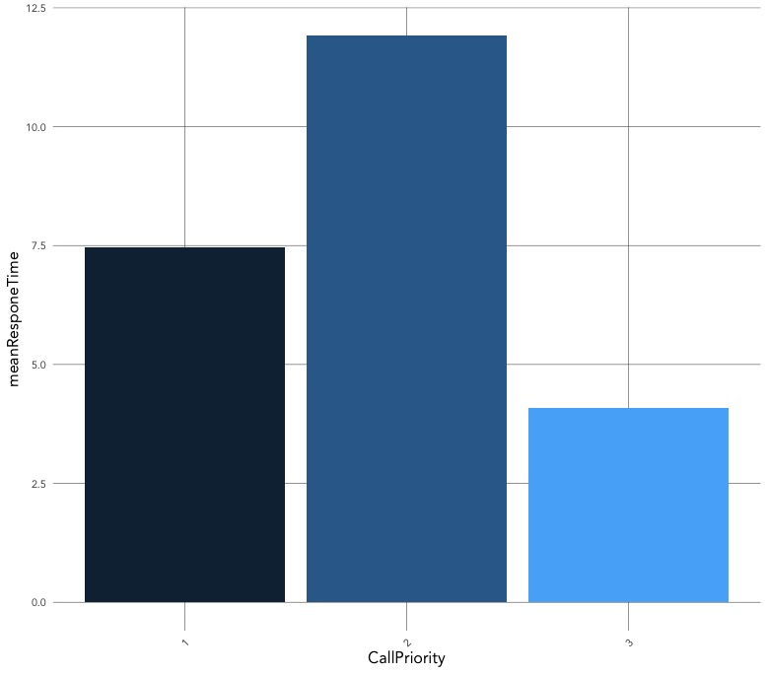
Patterns from
Historical Calls
Incident Priority
Priority 2 incidents have the longest response time
Priority 1 – life threatening, salvageable
Head injuries
Severe burns
Heart attack
Breathing impaired
Internal injuries
Priority 2 – Moderate/Serious injury, not life threatening
Fractures
Post-stroke, but stable
Altered mental status
Priority 3 – “Walking Wounded”,
Notes:
The first feature of these calls that will help us make predictions is the call’s priority. Based on the chart to the right, we can see that calls with priority 2 incident classifications tend to have the highest response times. These incidents include moderate-serious injuries that are not life threatening.

Slide 8
Patterns from
Historical Calls
Time of Day, Day of Week
Delays are related to Time and space
EMS Stations
Notes:
Another feature that will be helpful in making predictions is the time of the call and distance from EMS stations. The data will allow us to analyze how delays are different throughout the week and across Virginia Beach. If we look at the bright-yellow dots, we’ll see that some of the longest wait times are in the farthest away between ems stations.

Slide 9
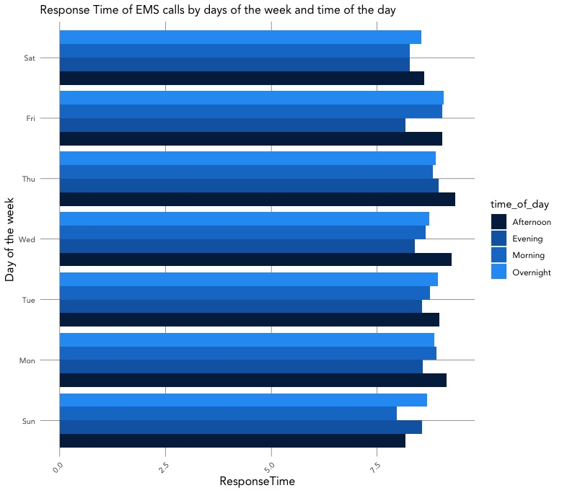
Patterns from
Historical Calls
Time of Day, Day of Week
Afternoon and Overnight Calls have the longest wait times
Notes:
If we focus only on the temporal relationship of delays on this chart, we can see that Afternoon and overnight calls tend to have the longest wait times, while evening and morning calls have the shortest wait times. Times consistently exceed 8 mins for all afternoon calls. Thursdays and Wednesdays tend to have the longest wait times.

Slide 10
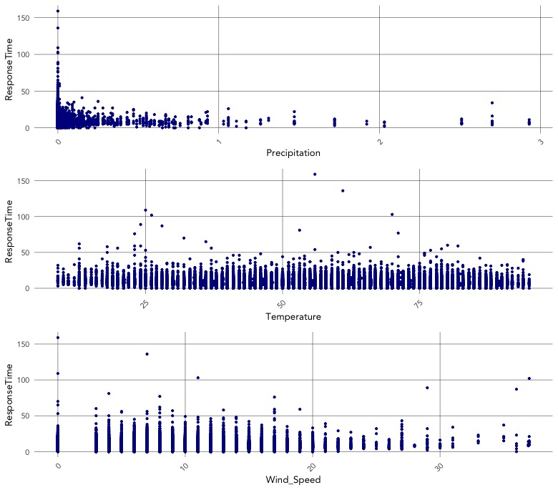
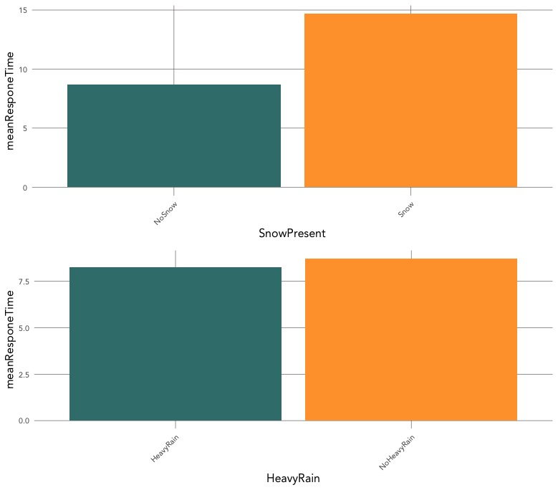
Patterns from
Historical Calls
Weather
Snowy days have longer wait times
Notes:
We’ve been examining how weather might impact EMS arrival. We’ve analyzed precipitation, temperature, and wind speed, but found that one of the only clear predictors for delays was whether or not it was snowing that hour.

Slide 11
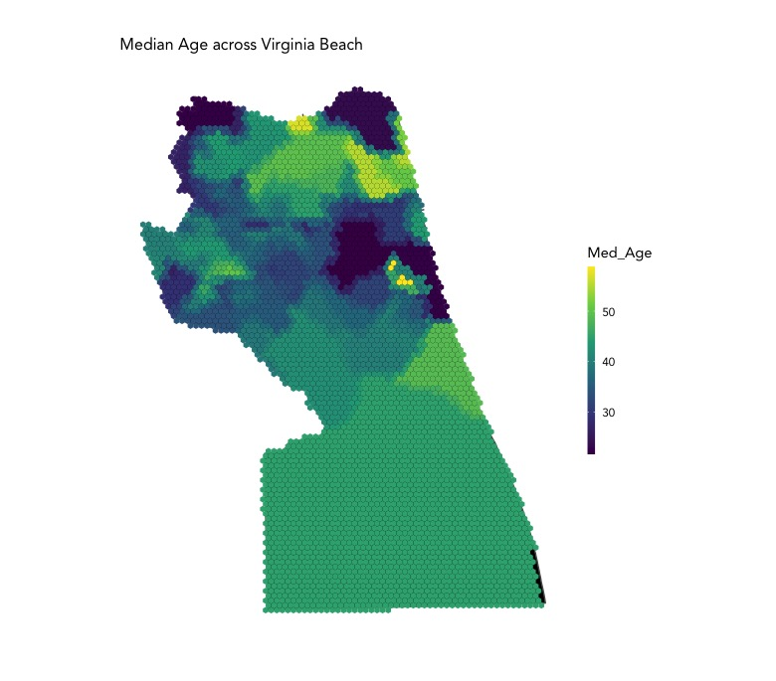
Patterns from
Historical Calls
Population
Areas with Older Populations have longer wait times
Notes:
Finally, we’ve also began to analyze population demographics, and are finding that regions of Virginia beach with older populations tend to have some of the longer response times. And while we know that EMS services are not purposefully delaying EMS services for older populations, but there may be other spatial factors that interact with age variables.

Slide 12
Predicting Response Time in EMS arrival
Al-Jalil Gault | David Park | Public Policy Analytics
Notes:
Thank for your listening to this presentation. We know that an application which helps users understand how long it will take before an EMS arrives will help users make the safest, most timely decisions to support their well-being.

